Slide 1
CptS 327
Hashing, TLS, AEAD
Notes:
Template-WSU Hrz 201.ppt

Slide 2
Today’s Topics
Overview
  Properties of Hash Functions
  SHA-512
  TLS
  AEAD
Notes:
Template-WSU Hrz 201.ppt

Slide 3
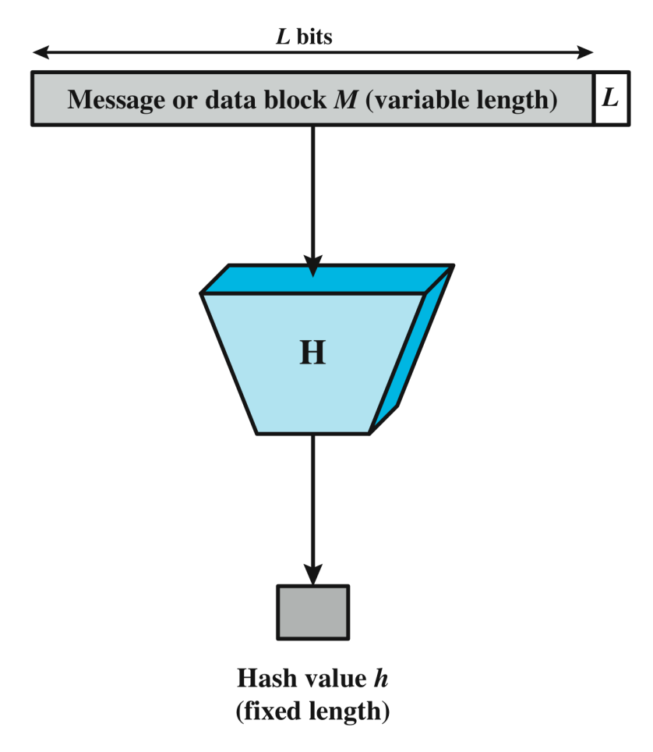
Hash Functions Recap
One-way function, h = H(M)
Creates a unique ‘digest’ of a message
Used in
  HMACs
  Password storage
  Digital checksums
Popular implementations
  SHA and MD5
Notes:
Template-WSU Hrz 201.ppt

Slide 4
Properties of Hash Functions
Preimage Resistance
  Given a hash, the plaintext shouldn’t be decipherable
  If h = H(M), and given h, it should be impossible to find M
Example
  Given: 799772e0410af26e43ee279af9f630150c7bb8bb
  Actual message:
    ‘This is a test message to demonstrate hash functions’
Notes:
Template-WSU Hrz 201.ppt

Slide 5
Properties of Hash Functions
Duplicity Resistance aka Second Preimage Resistance
  For a message, a hash function should always produce the same hash
  Given M1, H(M1) should always be h1
Example
  Given
    ‘This is a test message to demonstrate hash functions’
  SHA-1 should always hash the message to
    799772e0410af26e43ee279af9f630150c7bb8bb
Notes:
Template-WSU Hrz 201.ppt

Slide 6
Properties of Hash Functions
Collision Resistance
  For two unequal messages, their hashes should never be the same
  Given M1 != M2, H(M1) should never be the same as H(M2)
Example
  Given
    ‘This is a test message to demonstrate hash functions’
    799772e0410af26e43ee279af9f630150c7bb8bb
  Should be impossible to find the same hash for a message that is not:
    ‘This is a test message to demonstrate hash functions’
Notes:
Template-WSU Hrz 201.ppt

Slide 7
Properties of Hash Functions Exercises
Trial 1:
  Hash: 90289b5c8a65f536b7b5a03b8d38ea32d991bd91
  Function: SHA1
  What is the plain resource?
Trial n:
  Hash: 403926033d001b5279df37cbbe5287b7c7c267fa
  Function: SHA1
  What is the plain resource?
Our inability to discern plain resource from the hash satisfies which property?
Notes:
Template-WSU Hrz 201.ppt

Slide 8
Properties of Hash Functions Exercises
Trial 1:
  Message: ‘This is a test message to demonstrate hash functions’
  Function: SHA1
  Hash: 799772e0410af26e43ee279af9f630150c7bb8bb
Trial n:
  Message: ‘This is a test message to demonstrate hash functions’
  Function: SHA1
  Hash: 799772e0410af26e43ee279af9f630150c7bb8bb
Consistency of hash generation satisfies which property?
Notes:
Template-WSU Hrz 201.ppt

Slide 9
Properties of Hash Functions Exercises
Trial 1:
  Message: ‘This is a test message to demonstrate hash functions’
  Function: SHA1
  Hash: 799772e0410af26e43ee279af9f630150c7bb8bb
Trial n:
  Message: ‘This is a test message to undermine hash functions’
  Function: SHA1
  Hash: 799772e0410af26e43ee279af9f630150c7bb8bb
Different plain resources producing the same hash undermines which property?
Notes:
Template-WSU Hrz 201.ppt

Slide 10
Hash Functions
MD5
  128 bits
  No longer collision resistant
    ‘Flame’ malware: produces same MD5 checksum as a legitimate Windows Update
Secure Hashing Algorithm (SHA-1)
  160 bits
  Popular in current online use
  No longer collision resistant
    MS and Google stopped using SHA-1 in 2017
    https://www.schneier.com/blog/archives/2012/10/when_will_we_se.html
    $700k to compute a collision for SHA-1
Notes:
Template-WSU Hrz 201.ppt

Slide 11
Hash Functions
SHA-2
  256 or 512 bits
  Doubtful collision resistance
SHA-3
  No fixed hash length
    Changes from instance to instance
    Common: SHA3-224, 256, 384, 512
  Collision resistant until recently
    Quantum computers have started being able to compute collisions
Notes:
Template-WSU Hrz 201.ppt

Slide 12
SHA512 Hash Function
Ensure the initial state is at least 1024 bits
  Add variable pad (VP) and constant pad (CP) if not
Segment initial state into N fragments
  N value is configurable
  Ensure each fragment is 1024 bits by padding VP and CP
Hash each fragment individually
Add all fragments via XOR to produce the final hash
Notes:
Template-WSU Hrz 201.ppt

Slide 13
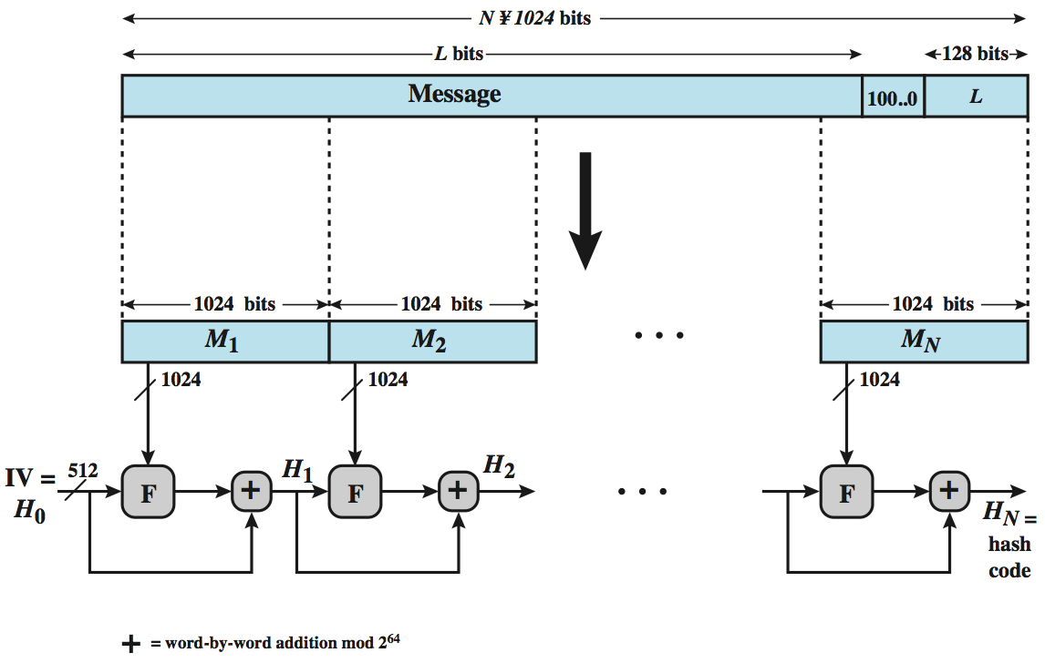
SHA-512 Hash Function
Notes:
Template-WSU Hrz 201.ppt

Slide 14
Security for Transmission
TCP/IP Stack
Security Protocols
How to securely transmit across a network?
  Ensure CIA of transmission
Application
(HTTP,SMTP)
HTTPS/
DNSSEC
Transport
(TCP/UDP)
Transport
(TCP/UDP)
Internet
(IP)
Internet
(IPSEC)
Network
(Ethernet)
Network
(802.11i)
Unsecure
Secure
Notes:
Template-WSU Hrz 201.ppt

Slide 15
Transport Layer Security (TLS)
An improvement of SSL (Secure Socket Layer)
Runs over TCP
Datagram TLS available for UDP
Implementations exist for connecting to HTTPS and other app layer protocols
Provides
  Integrity and Auth using MACs
  Confidentiality using encryption
Notes:
Template-WSU Hrz 201.ppt

Slide 16
Transport Layer Security (TLS)
TLS / SSL Versions
  SSL 1.0 / 2.0 / 3.0: several cracks available widely
  TLS 1.0: BEAST vulnerability
  TLS 1.1: fixes issues exploited by BEAST
  TLS 1.2: upgrades from SHA-1 to SHA-2
  TLS 1.3: improved ciphers by reducing handshakes involved
Notes:
Template-WSU Hrz 201.ppt

Slide 17
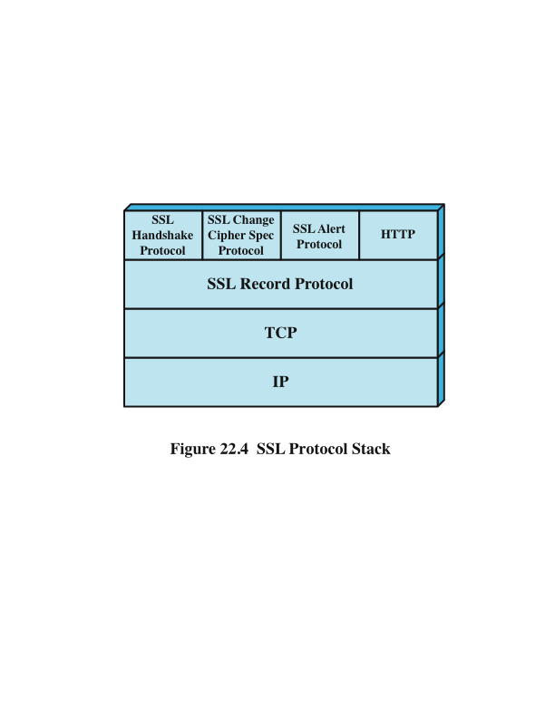
Transport Layer Security (TLS) Stack
Notes:
Template-WSU Hrz 201.ppt

Slide 18
Transport Layer Security (TLS)
TLS transmits payloads as ‘records’
  Records are compressed and encrypted
Record types
  TLS handshake
  HTTPS data
  System events e.g. alerts (bad certificate, decryption error etc.)
  Cipher switch specifications
Notes:
Template-WSU Hrz 201.ppt

Slide 19
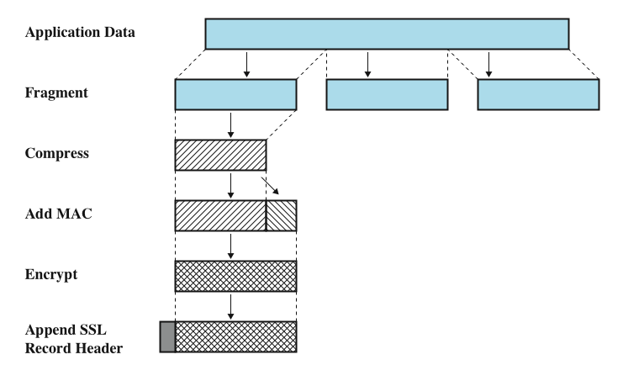
Transport Layer Security (TLS)
Notes:
Template-WSU Hrz 201.ppt

Slide 20
Transport Layer Security (TLS) Handshake
TLS creates a stateful connection
Handshake facilitates ‘statefulness’ by negotiating
  TLS version
  Ciphers
    RSA / DH for key exchange
    AES / RC4 for bulk encryption
    SHA-512 HMACs for integrity & auth
    Format: [SSL/TLS]_[key_exchange]_[signature_algorithm]_WITH_[symmetric cipher]_[auth]
      TLS_RSA_WITH_AES_128_CBC_SHA
  Certificates
  Preshared key
  Session ID
Notes:
Template-WSU Hrz 201.ppt

Slide 21
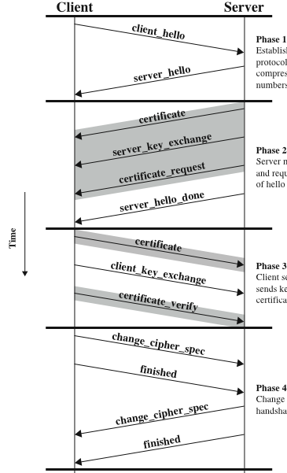
Transport Layer Security (TLS) Handshake
Proposes
1) version,
2) ciphers,
3) random number
Specifies:
1) version,
2) cipher,
3) random number
4) session id
Notes:
Template-WSU Hrz 201.ppt

Slide 22
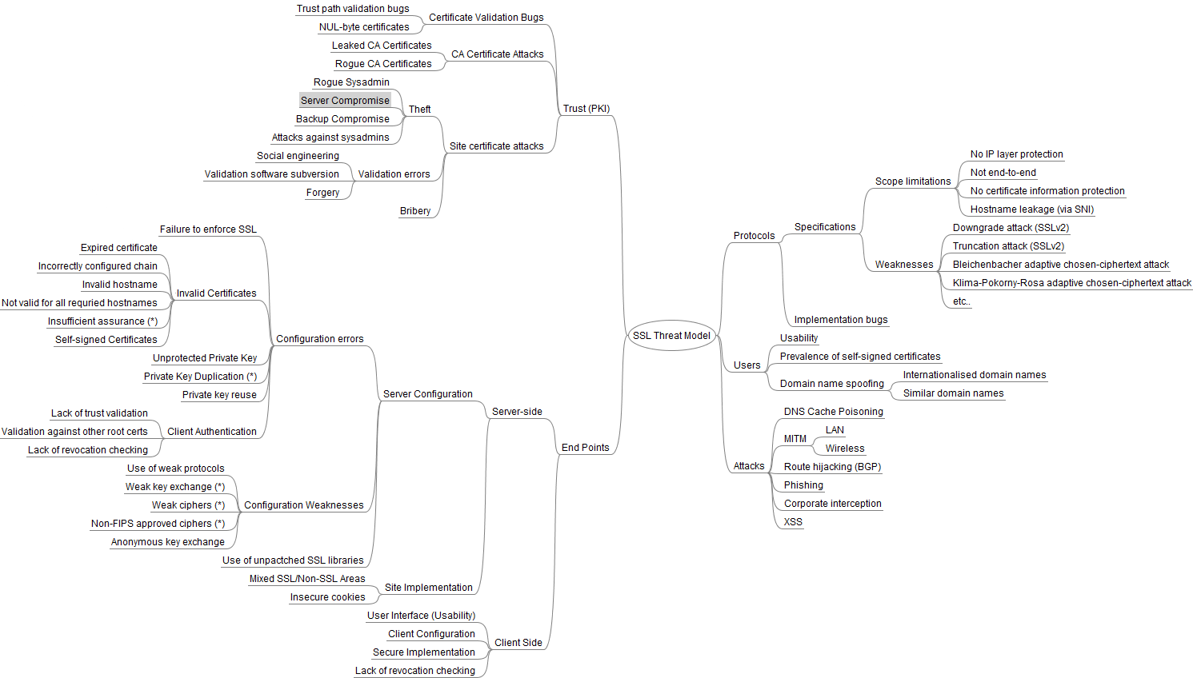
SSL Threats
https://www.ssllabs.com/projects/ssl-threat-model/
Notes:
Template-WSU Hrz 201.ppt

Slide 23
Attack on TLS/SSL
POODLE
  Padding Oracle on Downgraded Legacy Encryption
  SSLv3 still used as a legacy fallback in Windows Server versions
BEAST/CRIME attacks
  Compromising IV and/or index registers
    Reverse engineer
Need
  Ability to inject and run scripts from some web location
Notes:
Template-WSU Hrz 201.ppt

Slide 24
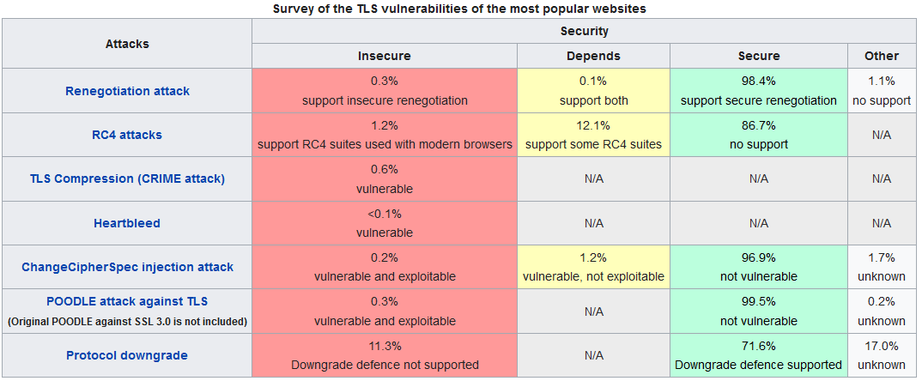
TLS Threats
https://www.ssllabs.com/ssl-pulse/
Notes:
Template-WSU Hrz 201.ppt

Slide 25
Authenticated Encryption and Assoc. Services (AEAS)
Previously known as AEAD: Auth Encryption & Assoc Data
Provides a sequence for security
  First authenticate then encrypt? or
  Encrypt first and authenticate next? Or
  Do both at the same time?
Example implementations
  Galois Counter Mode (GCM) E t A
  Offset Codebook Mode (OCB) A t E
  ChaCha20 and Poly1305 (E & A)
Notes:
Template-WSU Hrz 201.ppt

Slide 26
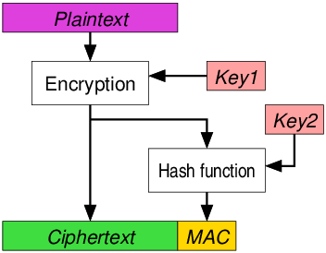
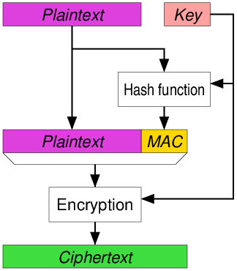
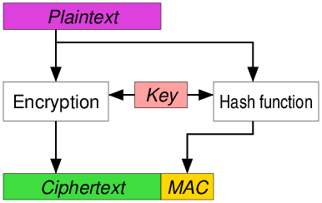
Notes:
Template-WSU Hrz 201.ppt

Slide 27
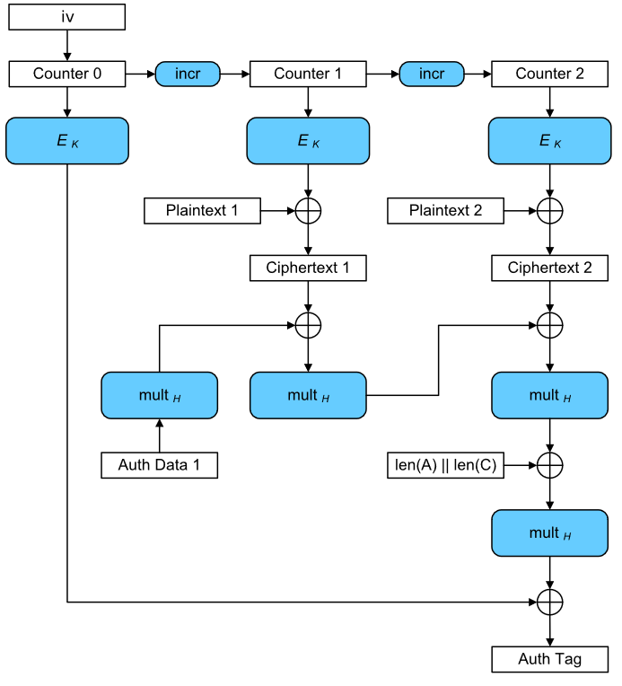
GCM
Notes:
Template-WSU Hrz 201.ppt

Slide 28
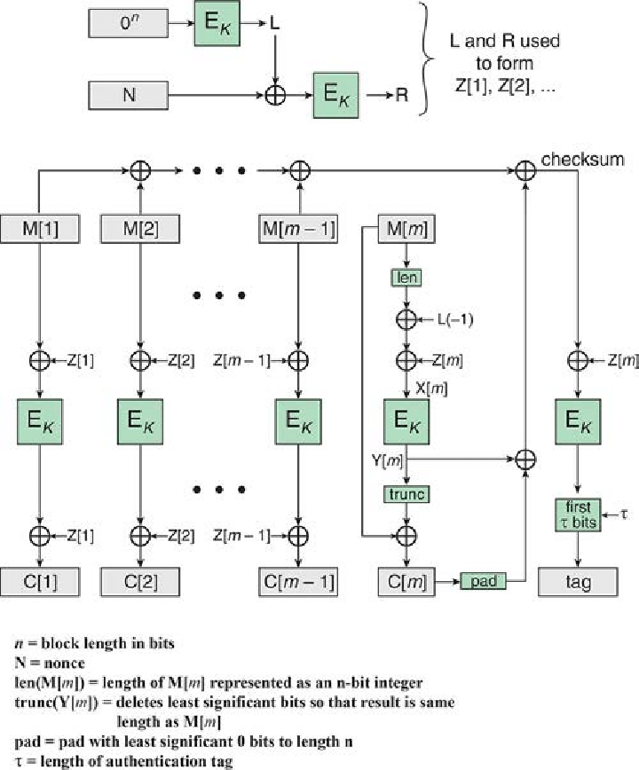
OCB
Notes:
Template-WSU Hrz 201.ppt

Slide 29
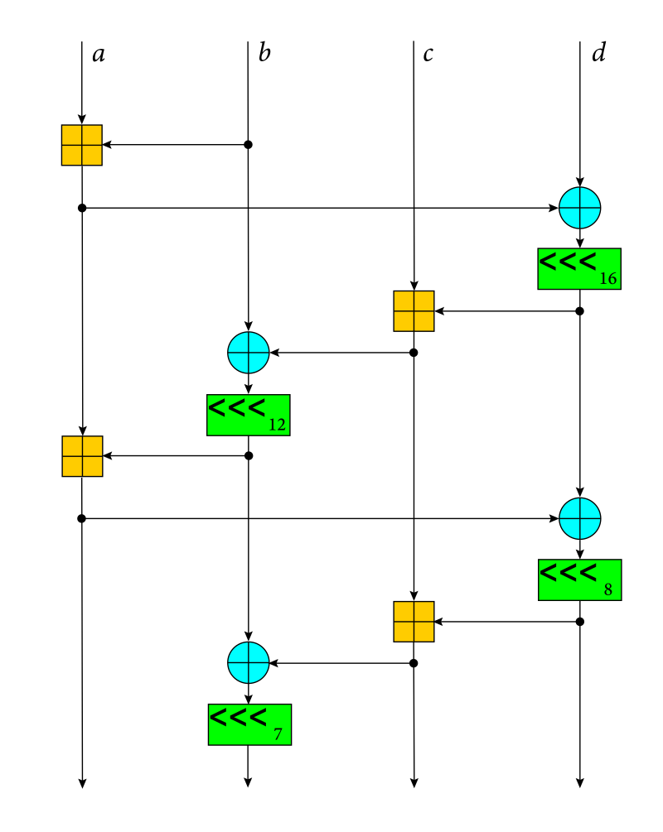
ChaCha20
Notes:
Template-WSU Hrz 201.ppt

Slide 30
Next lecture
VPN, Anonymity
Notes:
Template-WSU Hrz 201.ppt

Slide 31
Any questions?
Notes:
Template-WSU Hrz 201.ppt

